Slide 1
ARMed Frodo: FrodoKEM on 64-bit ARMv8 Processors
HyeokDong Kwon¹, KyoungBae Jang¹, HyunJun Kim¹, HyunJi Kim¹, MinJoo Sim¹, SiWoo Eum¹, Wai-Kong Lee² and HwaJeong Seo¹
¹Hansung University, ²Gachon University
21. 08. 13.

Slide 2
Introduction
Background
Proposed technique
Evaluation
Conclusion

Slide 3
Introduction
As the quantum computers improved, classic cryptography algorithms are threatened (e.g. RSA, ECC)
Post-quantum cryptography (PQC) is prepared for the quantum computer era
FrodoKEM is one of PQC
Round 3 alternate candidate
It takes a lot of time consumption than the other algorithms
In this paper, we improved FrodoKEM performance
Optimized matrix-multiplication based on parallel implementation

Slide 4
Introduction
Our contributions
Matrix-multiplication with parallel operations
Matrix-multiplication occurs huge computational loads
We used vector registers and vector instructions to implement parallel implementation
High-speed random number generation with AES accelerator
FrodoKEM used AES-128 encryption for random numbers generation
We replaced AES encryption to AES accelerator
First FrodoKEM implementation on 64-bit ARM processors
64-bit ARM processors are widely used in smartphone, tablet, ETC
We targeted 64-bit ARM processor, and it can be helpful for following researchers

Slide 5

Background: FrodoKEM
Lattice-based cryptography
Round 3 alternate candidate of NIST PQC standardization
Other algorithms: BIKE, HQC, NTRU Prime, and SIKE
In this paper, FrodoKEM-640 is targeted
Parameter | FrodoKEM-640 | FrodoKEM-976 | FrodoKEM-1344
Dimension n | 640 | 976 | 1344
Modulus q | 2¹⁵ | 2¹⁶ | 2¹⁶
Size of Public key | 9616-byte | 15632-byte | 21520-byte
Size of Private key | 19888-byte | 31296-byte | 43088-byte
Hash algorithm | SHAKE-128 | SHAKE-256 | SHAKE-256
Size of Cipher text | 9720-byte | 15744-byte | 21632-byte
Security level | 1-level (AES-128) | 3-level (AES-192) | 5-level (AES-256)

Slide 6
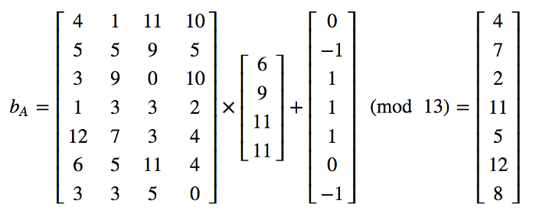
Background: FrodoKEM
Learning With Errors(LWE) based cryptography
Integer array: A
Private key: s
Error: e
Public key: B
B[] = A[] x s + e
Using Matrix multiplication
FrodoKEM matrix size is too large, it makes huge computational loads

Slide 7
Background: ARMv8 processor
31 64-bit general purpose registers (i.e. general scalar registers)
32 128-bit vector registers
Vector registers can be operated in parallel way
The arrangement specifier is used for the packing unit
Vector instructions (i.e. SIMD, NEON) are support to vector registers
ADD.8b v2, v0, v1
v0.8b
v1.8b
v2.8b

Slide 8
Proposed technique
Matrix-multiplication scheme
Output[0] = X[0]*Y[0] + X[1]*Y[N] + … X[N]*Y[N*M]
Too many operations are required to calculate single output
If, the matrix is larger, computational loads becomes greater
Matrix X
Matrix Y
*
=

Slide 9

Proposed technique
Parallel way
ARMed Frodo
Makes Matrix-multiplication in parallel way
With vector registers & instructions
On ARM processor
High speed Matrix-multiplication operation
Vector registers
Vector instructions

Slide 10
Proposed technique
Multiplication on vector registers
Store eight values in single register
10 registers are used → 80 values
What values should we load?
Seed A
x
Error
s
=
Out.

Slide 11
Proposed technique
i = 0, k = 0, j = 0
A[0] * s[0]
i = 0, k = 0, j = 1
A[1] * s[1]
i = 0, k = 0, j = 2
A[2] * s[2]
…
i = 0, k = 0, j = 639
A[639] * s[639]
i = 0, k = 1, j = 0
A[0] * s[640]
i = 0, k = 1, j = 1
A[1] * s[641]
i = 0, k = 1, j = 2
A[2] * s[642]
…
i = 0, k = 1, j = 639
A[639] * s[1279]
i = 0, k = 2, j = 0
A[0] * s[1280]
i = 0, k = 2, j = 1
A[1] * s[1281]
i = 0, k = 2, j = 2
A[2] * s[1282]
…
i = 0, k = 2, j = 639
A[639] * s[1919]
i = 0, k = 3, j = 0
A[0] * s[1920]
i = 0, k = 3, j = 1
A[1] * s[1921]
i = 0, k = 3, j = 2
A[2] * s[1922]
…
i = 0, k = 3, j = 639
A[639] * s[2559]
i = 0, k = 4, j = 0
A[0] * s[2560]
i = 0, k = 4, j = 1
A[1] * s[2561]
i = 0, k = 4, j = 2
A[2] * s[2562]
…
i = 0, k = 4, j = 639
A[639] * s[3199]
Seed A values are fixed
E.g.: s[640*k] is multiplied to A[0], A[640], … A[640]

Slide 12
Proposed technique
v31: s[k * 640]
v0–v18(even): A[i*640]
Loop index i is included in 1 loop
v1–v19(odd): Result
Accumulate multiplication results
End of loop, s, A pointer adjusted
Matrix values are not located linearly in memory
v31
S
[0]
S
[640]
S
[1280]
S
[1920]
S
[2560]
S
[3200]
S
[3840]
S
[4480]
v0
A
[0]
A
[0]
A
[0]
A
[0]
A
[0]
A
[0]
A
[0]
A
[0]
v2
A
[640]
A
[640]
A
[640]
A
[640]
A
[640]
A
[640]
A
[640]
A
[640]
v4
A
[1280]
A
[1280]
A
[1280]
A
[1280]
A
[1280]
A
[1280]
A
[1280]
A
[1280]
v18
A
[6400]
A
[6400]
A
[6400]
A
[6400]
A
[6400]
A
[6400]
A
[6400]
A
[6400]

Slide 13
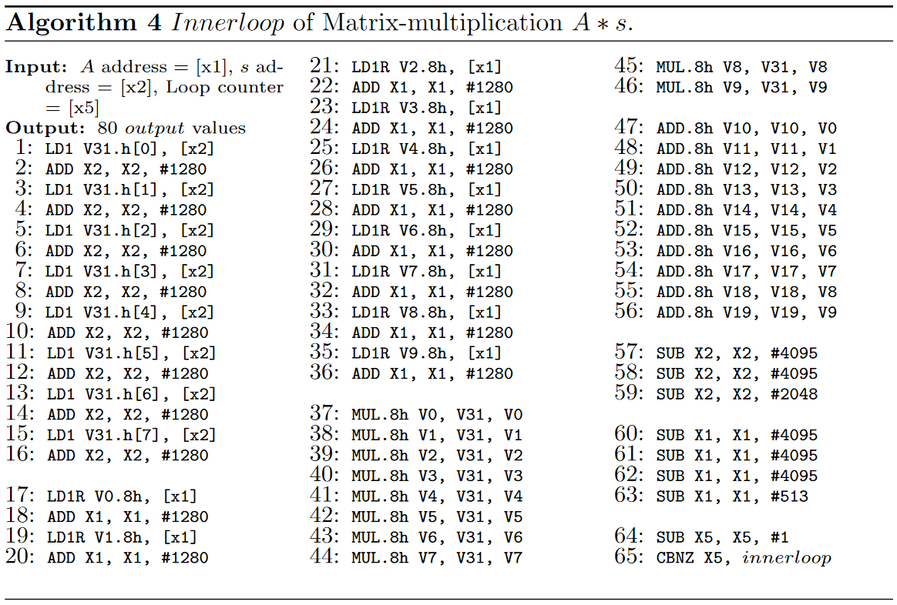
Proposed technique

Slide 14
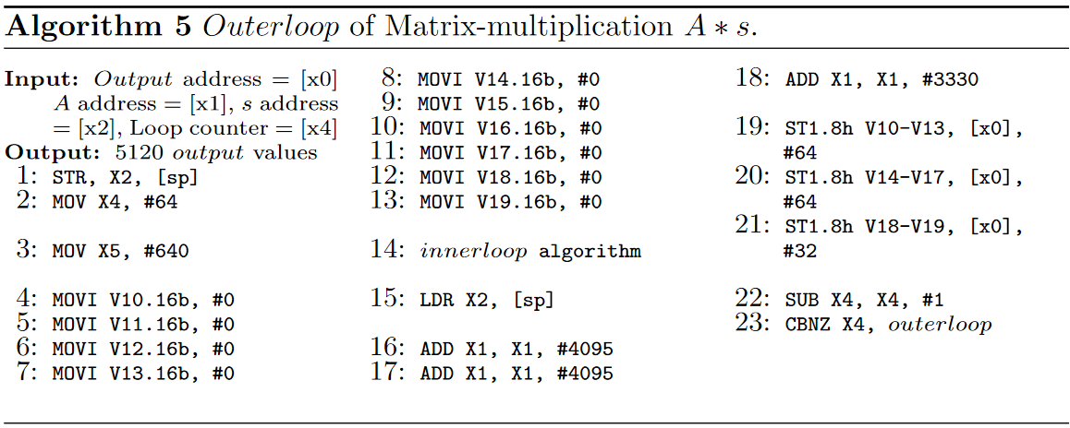
Proposed technique

Slide 15
Proposed technique
Matrix-multiplication s * A is similar with A * s
But, the order of the matrix values being called is different
i = 0, k = 0, j = 0
A[0] * s[0]
i = 0, k = 0, j = 1
A[640] * s[1]
i = 0, k = 0, j = 2
A[1280] * s[2]
…
i = 0, k = 0, j = 639
A[408960] * s[639]
i = 0, k = 1, j = 0
A[0] * s[640]
i = 0, k = 1, j = 1
A[640] * s[641]
i = 0, k = 1, j = 2
A[1280] * s[642]
…
i = 0, k = 1, j = 639
A[408960] * s[1279]
i = 0, k = 2, j = 0
A[0] * s[1280]
i = 0, k = 2, j = 1
A[640] * s[1281]
i = 0, k = 2, j = 2
A[1280] * s[1282]
…
i = 0, k = 2, j = 639
A[408960] * s[1919]
i = 0, k = 3, j = 0
A[0] * s[1920]
i = 0, k = 3, j = 1
A[640] * s[1921]
i = 0, k = 3, j = 2
A[1280] * s[1922]
…
i = 0, k = 3, j = 639
A[408960] * s[2559]
i = 1, k = 0, j = 0
A[1] * s[0]
i = 1, k = 0, j = 1
A[641] * s[1]
i = 1, k = 0, j = 2
A[1281] * s[2]
…
i = 1, k = 0, j = 639
A[408961] * s[639]

Slide 16
Proposed technique
v31: s[j]
v0–v18(even): A[j(0–79)]
v1–v19(odd): Result
Accumulate multiplication results
End of loop, A pointer adjusted
s pointer will be adjusted to initial point after 8 loops
v31
S
[0]
S
[0]
S
[0]
S
[0]
S
[0]
S
[0]
S
[0]
S
[0]
v0
A
[0]
A
[1]
A
[2]
A
[3]
A
[4]
A
[5]
A
[6]
A
[7]
v2
A
[8]
A
[9]
A
[10]
A
[11]
A
[12]
A
[13]
A
[14]
A
[15]
v4
A
[16]
A
[17]
A
[18]
A
[19]
A
[20]
A
[21]
A
[22]
A
[23]
v18
A
[72]
A
[73]
A
[74]
A
[75]
A
[76]
A
[77]
A
[78]
A
[79]

Slide 17
Evaluation
Target processor: Apple A10X Fusion (@2.38GHz)
Framework: Xcode 12.5
Language: Objective-C, C, ARM assembly
Compare with previous reference C implementation on target processor
PQClean: Post-quantum cryptography library in C language
The results use the average of 50 measurements
To reduce deviation
Each measurement operate previous/proposed algorithms 200 times
Total iteration count 10,000

Slide 18
Evaluation
Multiplier performance comparison
Proposed technique of matrix-multiplication is faster than previous work
A * s: 27.9 times
S * A: 43.8 times
 | A * s | s * A
Previous work | 2228.5ms (5303.0M) | 2557.7ms (6087.3M)
This work | 80.0ms (190.4M) | 58.4ms (139.0M)

Slide 19
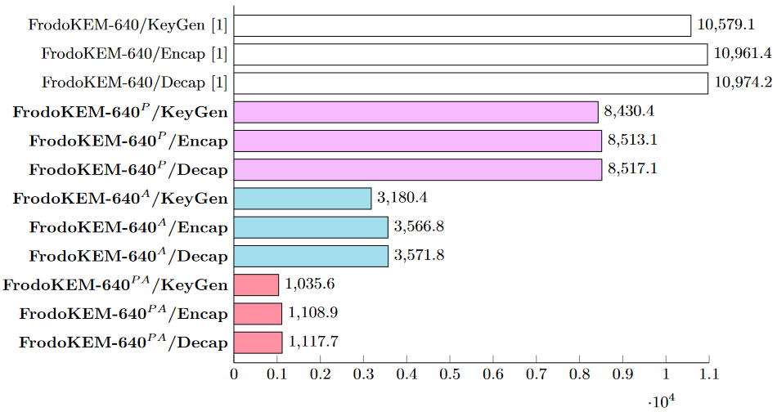
Evaluation
FrodoKEM-640 performance comparison
P: Parallel matrix-multiplication
A: AES accelerator
Performance enhancement
P: 1.25–1.30 times
A: 3.07–3.33 times
PA: 9.82–10.22 times

Slide 20
Conclusion
We show an implementation technique of FrodoKEM-640 on ARM
Parallel matrix-multiplication
Using AES accelerator
The multiplier has 27.9 times and 43.8 times better performance than multiplier of previous work
As a result of applying the proposed technique, the performance of FrodoKEM is improved
In best case, it shows 10.22 times better performance
Implementation of FrodoKEM-976, 1344 presented as a future works

